Slide 1

Project Seminar on Real-Time Chatting Application
Presented By
Vedant Chimote
CS19B44
Guided By
Roshani Kambe Mam
Department of Computer Science & Engineering
S. B. JAIN INSTITUTE OF TECHNOLOGY MANAGEMENT AND RESEARCH,NAGPUR
An Autonomous Institute, Affiliated to RTMNU, Nagpur

Slide 2
Contents
Problem Statement & Objectives
Introduction
Working
System Architecture
Technology to be Used
Screenshots
References
2
S. B. Jain Institute of Technology Management and Research

Slide 3
Problem Statement & Objectives
Problem Statement :
To develope a simple chatting application using Java.
Objectives :
To make an effective communication between two individuals by implementing the client-server architecture.
3
S. B. Jain Institute of Technology Management and Research

Slide 4
Introduction
The emergence of computer networks and telecommunication technologies allows people to communicate in a new way. Chatting is a method of using technology to bring people and ideas together despite geographical barriers.
We are developing Desktop based whatsapp like looking Chatting Application using Swing and Java Networking. Mainly we are gonna use the core java as primary language for development. Moreover the project is built in purely java making use of :
Java AWT : Java AWT (Abstract Window Toolkit) is an API to develop GUI or window-based applications in java.
Java Swing : Java Swing tutorial is a part of Java Foundation Classes (JFC) that is used to create window-based applications. It is built on the top of AWT (Abstract Windowing Toolkit) API and entirely written in java.
Java Socket Programming : Java Socket programming is used for communication between the applications running on different JRE. Java Socket programming can be connection-oriented or connection-less.
S. B. Jain Institute of Technology Management and Research
4

Slide 5
Working
Firstly , we will need to create the window frames as GUI for actual chatting. So for Implementing this, will import the Swing Package and AWT Package. Specifically, we will be using JLabel, JTextField, JTextArea, JPanel, JButton from Swing Package and ImageIcon class from the AWT package to display the user dp. And we will be using Intellij Idea as our ide.
We will be doing this for two times once for the server part and again for the client part. As we are making our window look like the whatsapp app’s chat activity, we will be placing the required icons and other elements at the specific position using the setBounds() method where we need to pass the co-ordinates to set the position. And also performing certain events via those icons and buttons.
We gonna need to apply certain attributes for better designing of the various elements like textField ,Buttons ,InputBar and the main area where the chats will be displayed. So for adding the required attributes to these elements we will be calling certain methods like setText(), setBackground(), setForeground(), etc.
We have added certain extra yet important features like the Time-Date, which will be marked as when the message will be sent and received by the respective user. Also we are displaying the current status of counter user as reading or typing.
S. B. Jain Institute of Technology Management and Research

Slide 6
5. Now its time for the networking programming part which will be carried through the Java Socket Programming which consist of mainly two classes namely Socket and SocketServer for effective communication. For server part we need to make use of both Socket and SocketServer class while for the Client part only Socket class is required. The exchange of textual data between our client and server is handled with the help of DataInputStream to read the received message and DataOutputStream to send the typed message which is implemented in both ie. Client and Server.
6. Some special care was taken to keep the connection alive between the server and client.And to close the connection after the windows are closed.
The corresponding code for the above logic has been elaborated properly using proper comments. So reading and understanding code wont be tough.
S. B. Jain Institute of Technology Management and Research

Slide 7
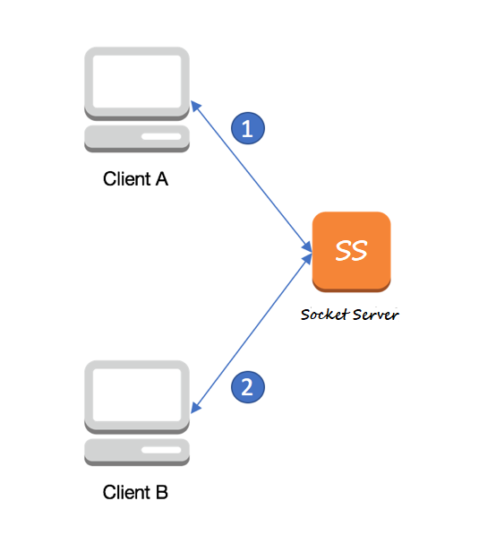
System Architecture
S. B. Jain Institute of Technology Management and Research
7

Slide 8
Technology to be Use
Front End: Java (AWT & Swing)
Back End: core Java
Library/API/Framework: Java Networking via Socket Programming
IDE: Intellij idea
Hardware used: Personal computer running Windows 10
S. B. Jain Institute of Technology Management and research
8

Slide 9
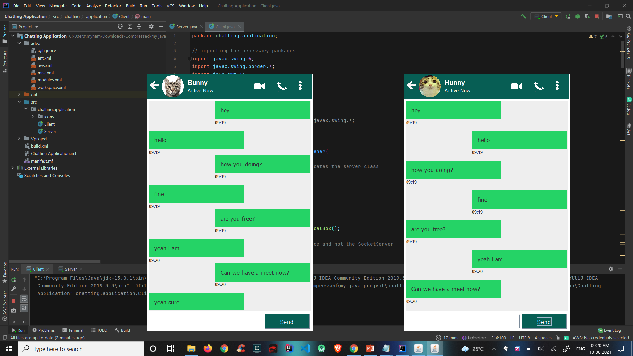
Screen Shots
S. B. Jain Institute of Technology Management and Research
9

Slide 10
References
Websites:
https://www.javatpoint.com
https://github.com/
https://stackoverflow.com/
https://docs.oracle.com/en/java/
S. B. Jain Institute of Technology Management and Research
10

Slide 11
Thank You

